Slide 1
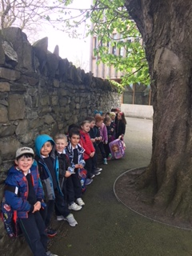
A day in the Life……

Slide 2
We line up

Slide 3
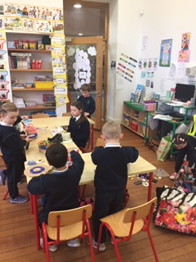
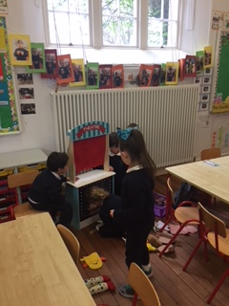
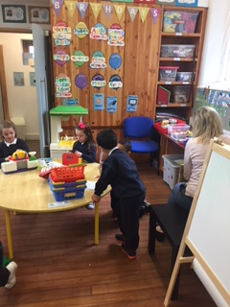
Play time
Construction - polydrons
Make and Do – Junk Art
Small World – Puppet show
Role Play – at the supermarket

Slide 4
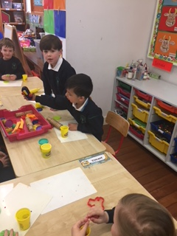
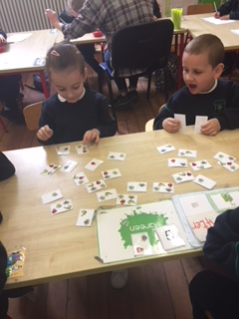
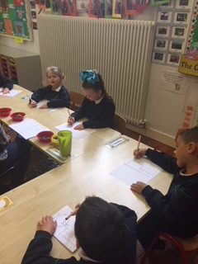
Maths Groups
Station teaching
Shapes – play dough
Adding – partitioning 5
Writing the number 5

Slide 5
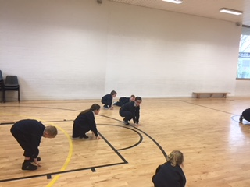
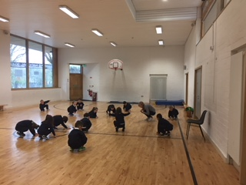
PE Time
Stretching, making shapes
with our bodies –
athletics and playground games.

Slide 6
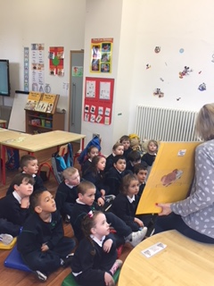
Story time
Relaxing on the mat listening to
and discussing The Little Red Hen.

Slide 7
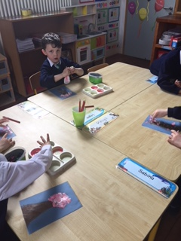
Art time
Finger painting Cherry Blossom trees.

Slide 8
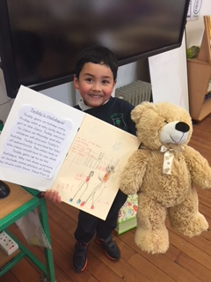
Teddy and his adventures
I brought Teddy home for the weekend
and I am sharing with my class, all the exciting
things we did together.

Slide 9
Time for yard

Slide 10
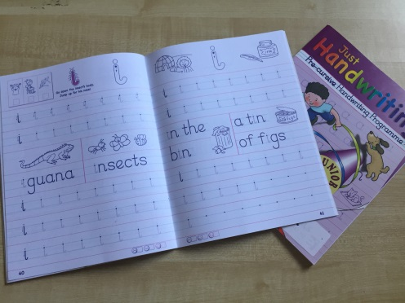
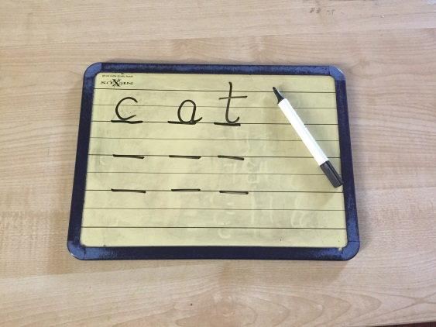
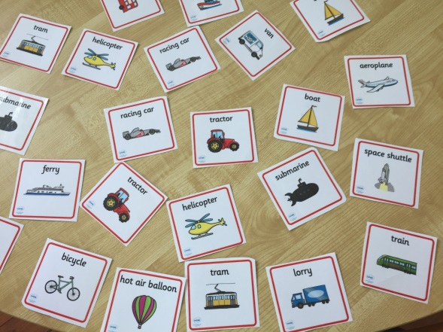
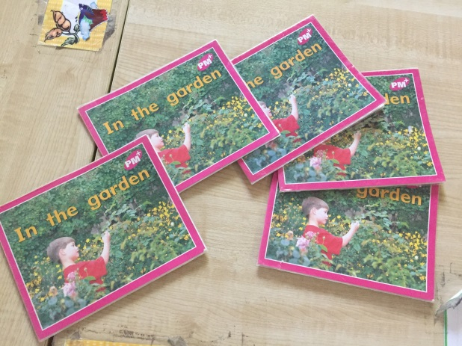
English Groups
Station teaching
Letter formation
Phonics – blending
and sounding out
Oral Language Development
-Transport
Reading

Slide 11
Home time
We have had
a very busy
day

